Slide 1
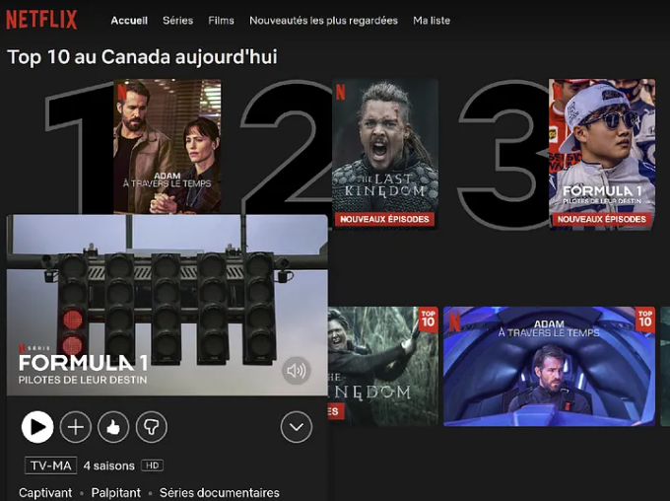
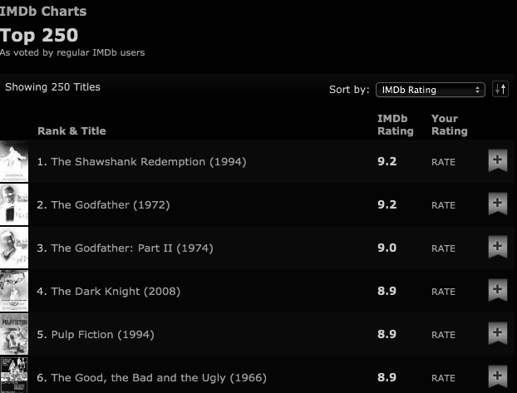

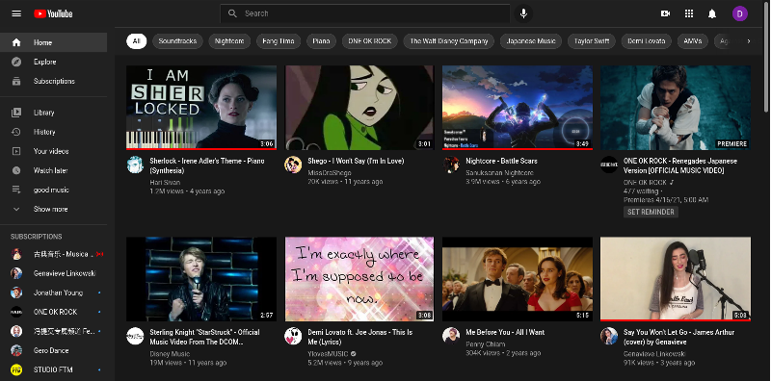
Recommendation System

Slide 2



Simple Recommender
Recommendation System
Content Based Recommender
User Based
Collaborative Filtering
Item Based

Slide 3
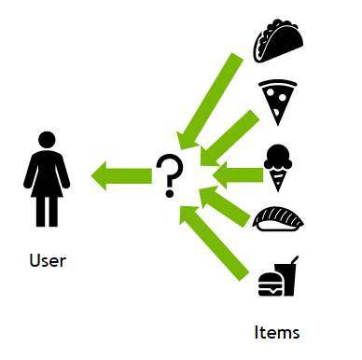
Working

Slide 4
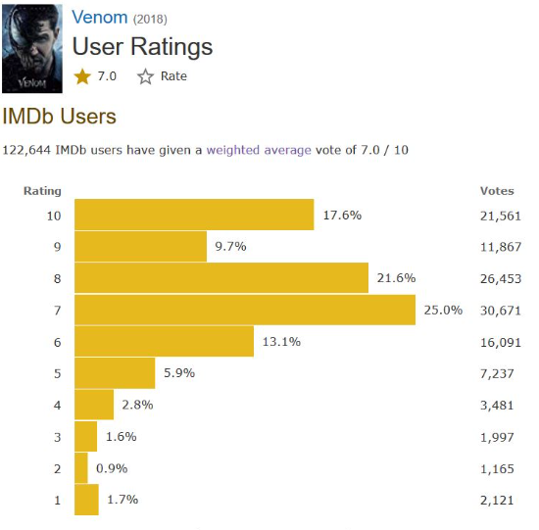
Simple Recommenders
Popularity Ranking: Ranks movies based on their popularity metrics or genre-specific popularity.
Filtering: Filters out movies that do not meet the popularity or genre criteria.
Recommendation Generation: Recommends the top-ranked or most popular movies to the user.
The following are the steps involved:
Decide on the metric or score to rate movies on.
Calculate the score for every movie.
Sort the movies based on the score and output the top results.

Slide 5
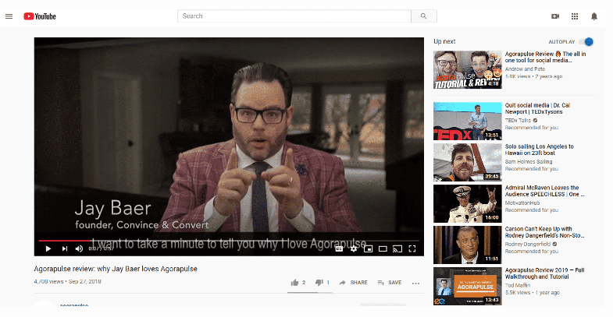
Content-based recommenders
Item Metadata: Collects information about items such as genre, director, actors, plot summary, etc.
Profile Creation: Builds a user profile based on their past interactions or explicit preferences.
Similarity Calculation: Measures the similarity between items based on their metadata and the user profile.
Recommendation Generation: Recommends items that are similar to those the user has interacted with positively.

Slide 6

Collaborative filtering engines
User-Item Interaction Matrix: Represents users' ratings or interactions with items.
Similarity Calculation: Measures the similarity between users or items based on their past interactions.
Prediction Generation: Predicts the rating or preference a user would give to an item by combining the ratings of similar users or items.
Recommendation Generation: Recommends items with the highest predicted
User-based Collaborative Filtering: Recommends items to a target user based on the preferences of users who are similar to them.
Item-based Collaborative Filtering: Recommends items that are similar to items the user has already interacted with or rated positively.

Slide 7


Advantage
Disadvantage

Slide 8

Benefits of Generalized Recommendations:
Accessibility: Offers a wide range of movies that are likely to be enjoyed by the average audience.
Simplicity: Does not require complex user profiles or personalized preferences, making it suitable for a broad user base.
Broad Appeal: Appeals to users who may not have specific preferences or are looking for popular and widely acclaimed movies.
Challenges and Limitations:
Lack of Personalization: May not provide tailored recommendations based on individual tastes and preferences.
Limited Diversity: Tends to recommend popular or mainstream movies, potentially overlooking niche or lesser-known gems.
Changing Trends: Popularity and critical acclaim can fluctuate over time, affecting the relevance of recommendations.

Slide 9

Benefits of Content-based Recommender Systems:
Personalization: Tailors recommendations to individual user preferences and tastes.
Diversity: Recommends a variety of items based on different aspects of item metadata.
Serendipity: Introduces users to new items they may not have discovered otherwise.
User Engagement: Increases user engagement by providing relevant and interesting recommendations.
Challenges and Limitations:
Over-specialization: Recommending similar items may lead to a lack of diversity in recommendations.
Cold-start Problem: Difficulty in making recommendations for new users with limited interaction history.
Limited Serendipity: Content-based systems may struggle to recommend unexpected or novel items outside the user's preferences.

Slide 10

Benefits of Collaborative Filtering:
No Need for Item Metadata: Does not require item metadata such as genre, director, or actors, making it suitable for a wide range of applications.
Serendipitous Recommendations: Introduces users to new items based on the preferences of similar users, leading to serendipitous discoveries.
Scalability: Scales well with large datasets and can handle a large number of users and items efficiently.
Challenges and Limitations:
Cold-start Problem: Difficulty in making recommendations for new users with limited interaction history or new items with few ratings.
Data Sparsity: Sparse user-item interaction matrices can lead to inaccurate predictions, especially for niche items or users.
Popularity Bias: Tends to recommend popular items over niche or less well-known items, leading to a lack of diversity in recommendations.

Slide 11

Attack-Resistant Recommendation Systems

Slide 12
Types of Attacks on Recommendation Systems
Manipulation: Users attempt to artificially inflate or deflate the ratings or popularity of items to influence recommendations.
Sybil Attacks: Malicious users create multiple fake accounts to manipulate ratings or influence the recommendation algorithm.
Profile Injection: Injecting fake or biased user profiles into the system to skew recommendations.
Data Poisoning: Introducing fraudulent or misleading data into the recommendation system to undermine its accuracy and effectiveness.
https://static.googleusercontent.com/media/research.google.com/en//pubs/archive/34404.pdf

Slide 13

Strategies for Attack Resistance:
Robust Algorithms: Implementing recommendation algorithms that are resistant to manipulation and adversarial attacks.
Anomaly Detection: Monitoring user behavior and identifying abnormal patterns that may indicate fraudulent activity or attacks.
Reputation Systems: Assigning reputation scores to users based on their behavior and interactions to detect and mitigate malicious activities.
Data Sanitization: Filtering and sanitizing user-generated content and interactions to remove spam, fake reviews, or other malicious inputs.
Differential Privacy: Incorporating differential privacy techniques to protect user privacy and prevent adversaries from inferring sensitive information from recommendation data.

Slide 14
Example Techniques for Attack Resistance:
Trust-Based Filtering: Considering the trustworthiness of users and items when generating recommendations to mitigate the impact of malicious actors.
Robust Optimization: Formulating recommendation algorithms to optimize performance under adversarial conditions and resist manipulation attempts.
Adversarial Training: Training recommendation models with adversarial examples to improve resilience against adversarial attacks.
Community Feedback: Leveraging feedback from the user community to identify and address suspicious or fraudulent activities.

Slide 15
Benefits & Limitationsof Attack-Resistant Recommendation Systems:
Maintains Integrity: Ensures that recommendations are reliable and trustworthy, even in the presence of malicious actors.
Protects User Experience: Safeguards users from being misled or influenced by fraudulent recommendations or manipulative behavior.
Enhances Trust: Builds trust and confidence in the recommendation system among users by demonstrating its resilience to attacks and manipulation.
Trade-offs: Balancing attack resistance with other objectives such as recommendation accuracy, scalability, and user experience.
Adversarial Adaptation: Adversaries may adapt their strategies over time, necessitating continuous updates and improvements to defense mechanisms.
Overhead: Implementing attack-resistant mechanisms may incur additional computational overhead and complexity.

Slide 16
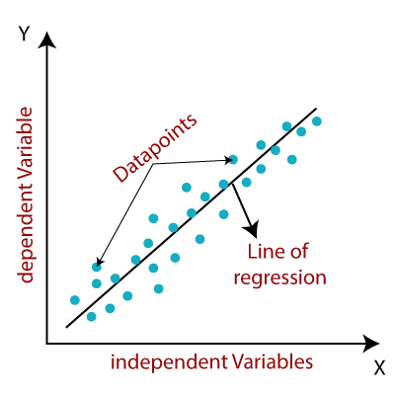
Understanding a Regression Problem
Regression belongs to the class of Supervised Learning tasks where the datasets that are used for predictive/statistical modeling contain Continuous labels..
Equation of linear regression:
y = a0 + a1x1 + a2x2 + … + aixi
Here,
y = response variable
xi = ith predictor variable
ai = average effect on y as xi increases by 1
In Linear Regression, we predict the value by an integer number.
Here no activation function is used.
Here we calculate Root Mean Square Error(RMSE) to predict the next weight value.

Slide 17
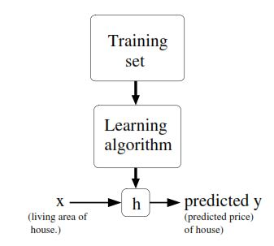

Slide 18



